Slide 1
Guide for FCC/CE/TELEC Certification Test
Oct. 2017
Copyright@2017 Cellion co Ltd All Rights Reserved
Cellion Co., Ltd

Slide 2
Guide for FCC/CE/TELEC
FCC
  Tx Command : ESP8285_RF_TEST_20171018.bin
CE
  Tx and Rx Command : ESP8285_RF_TEST_20171018.bin
  Adaptivity Test : ESP8285_CE_Adaptivity_20171018.bin
TELEC
  Tx and Rx Command : ESP8285_RF_TEST_20171018.bin
  Occupied Bandwidth and Spread-spectrum Bandwidth / Factor(14Channel) : ESP8266_TELEC_20171018.bin
**Using EMC mode for Tx/Rx Command
**Using SRRC mode for TELEC Occupied Bandwidth and Spread-spectrum Bandwidth / Factor(14Channel)

Slide 3
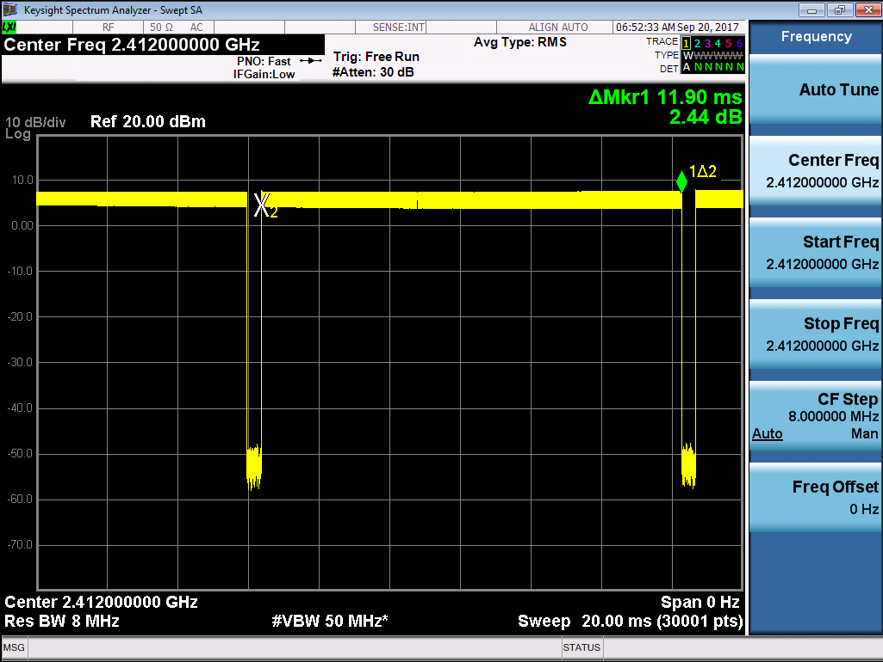
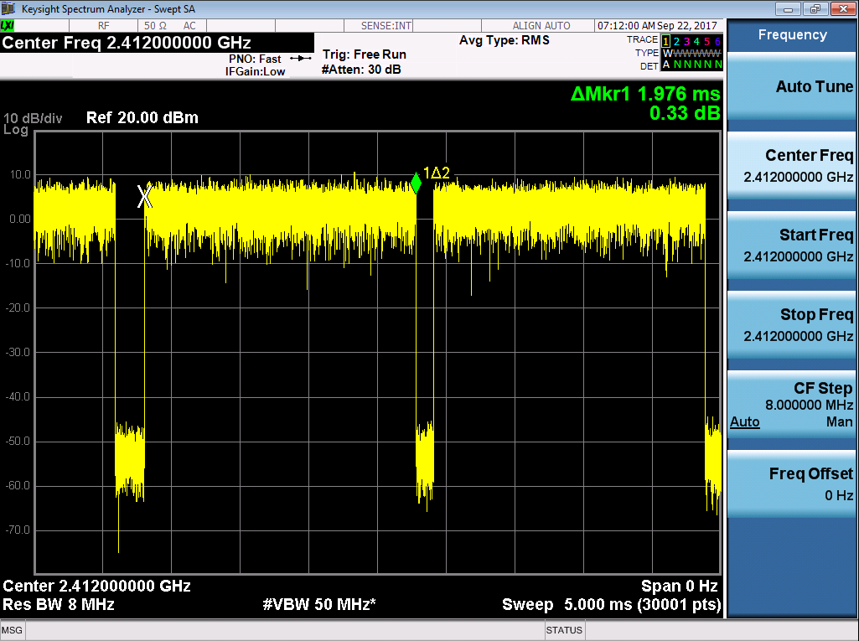
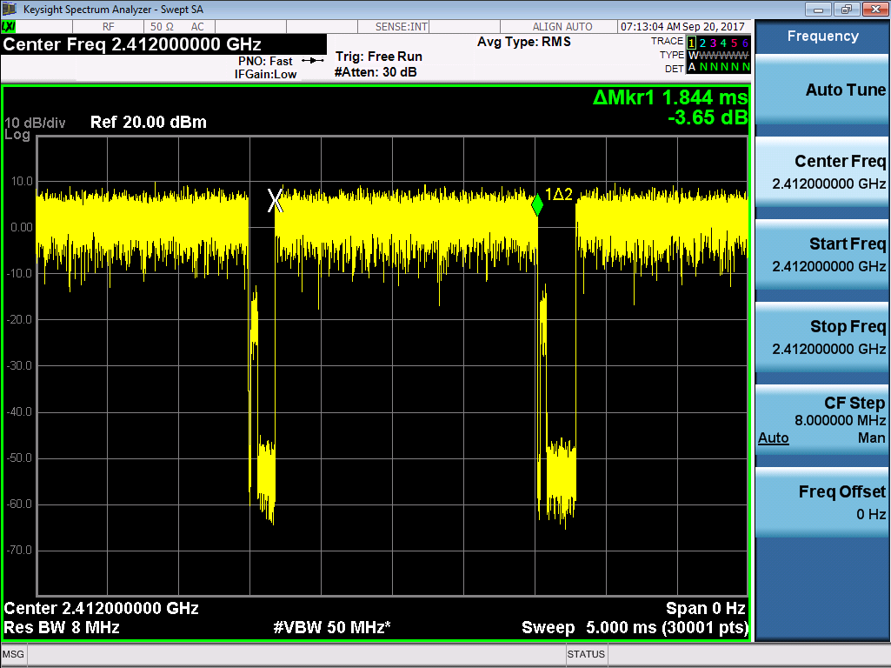
CE : Adaptivity Test
Using ESP8285_CE_Adaptivity_20171018.bin
Baudrate : 74880(with Both NL & CR)
Interference Level : -47 dBm @ 60 sec
Occupancy time : less than 12.8ms
  11.90ms @ B mode / 1Mbps
  1.976ms @ G mode / 6Mbps
  1.844ms @ N mode / MCS0(6.5Mbps)
B mode
1Mbps
11.90mS
Test Command
op -S -o 1
sleep -S -t 0
dhcp -E
ip -S -i 192.168.1.30 -m 255.255.255.0 -g 192.168.1.2
sta -C -s ap_2g_ht20 –p
phy -R -e 1 -f 1(1: 1M; 2: 6M; 3: 6.5M)
soc -B -t UDP -i 192.168.1.30
soc -C -s 0 -i 192.168.1.9 -p 5001
soc -S -s 0 -i 192.168.1.9 -p 5001 -l 1400 -n 1000000 -j 1
G mode 6Mbps
1.976mS
N mode MCS0(6.5Mbps)
1.844mS

Slide 4
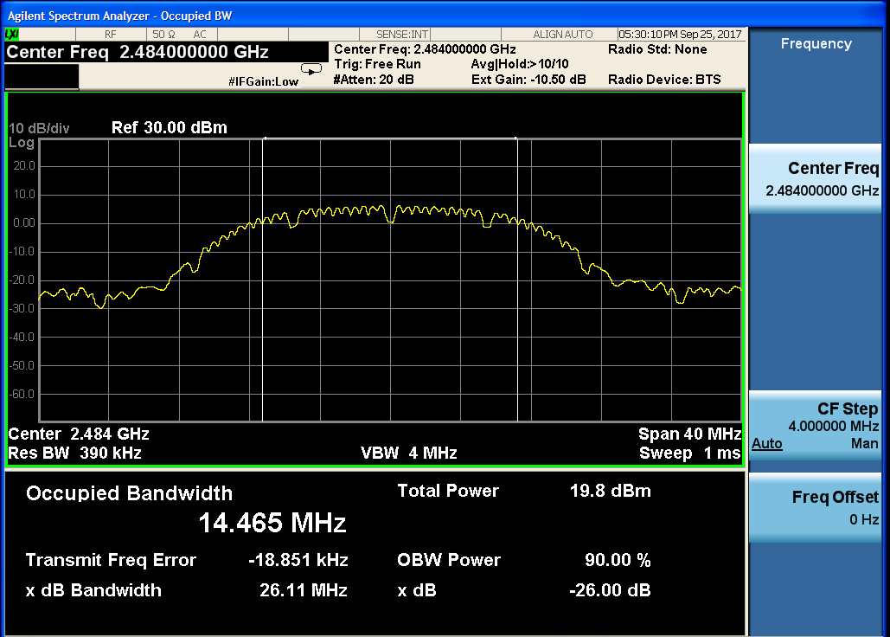
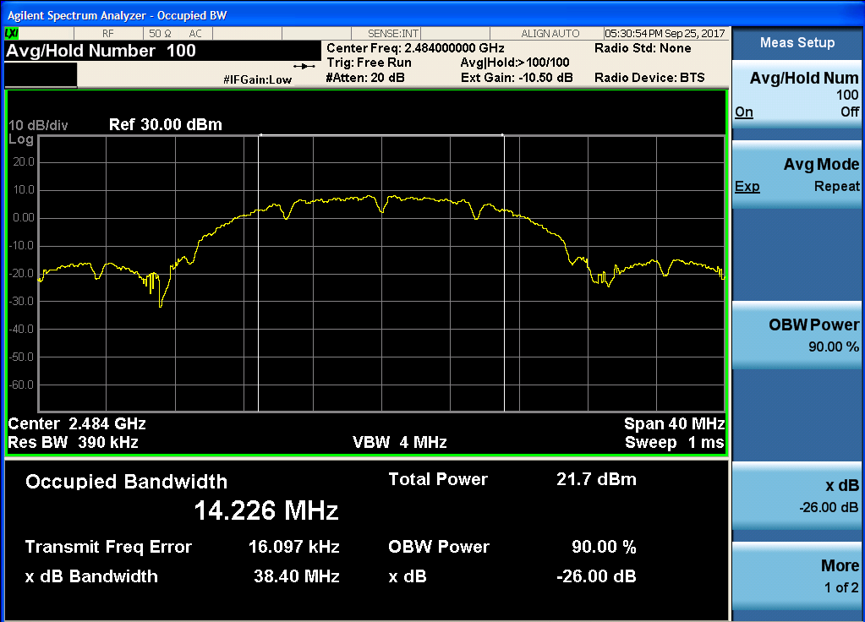
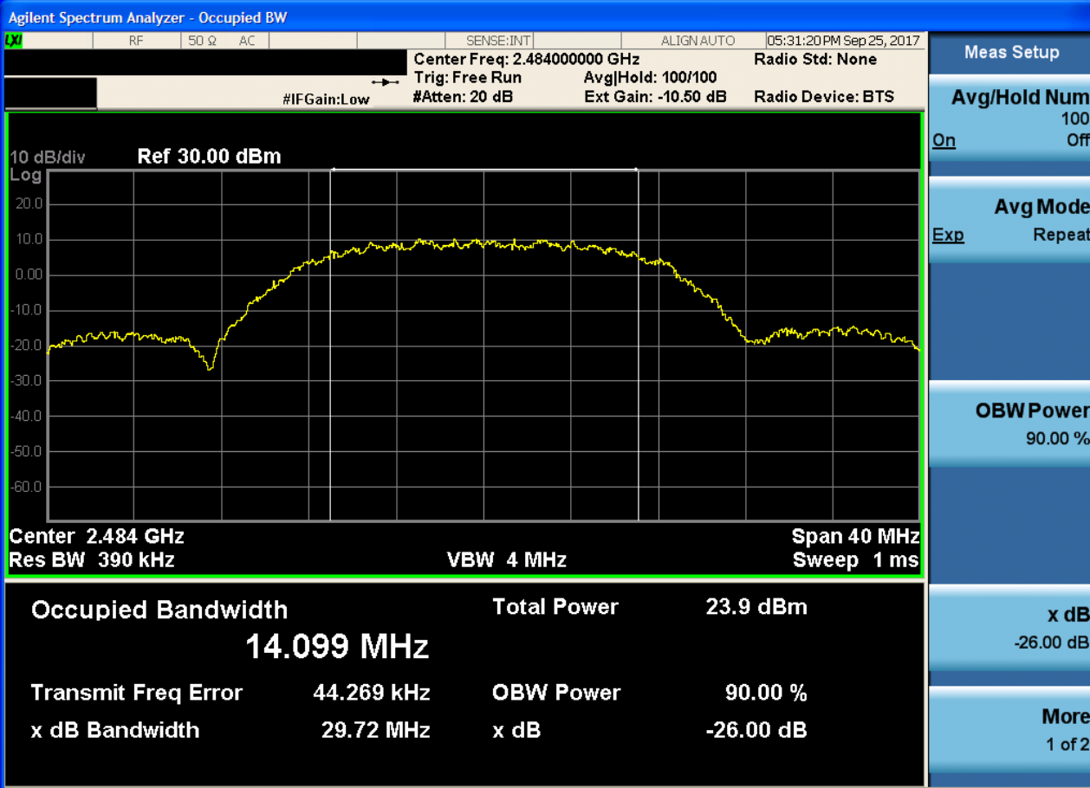
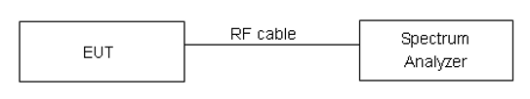
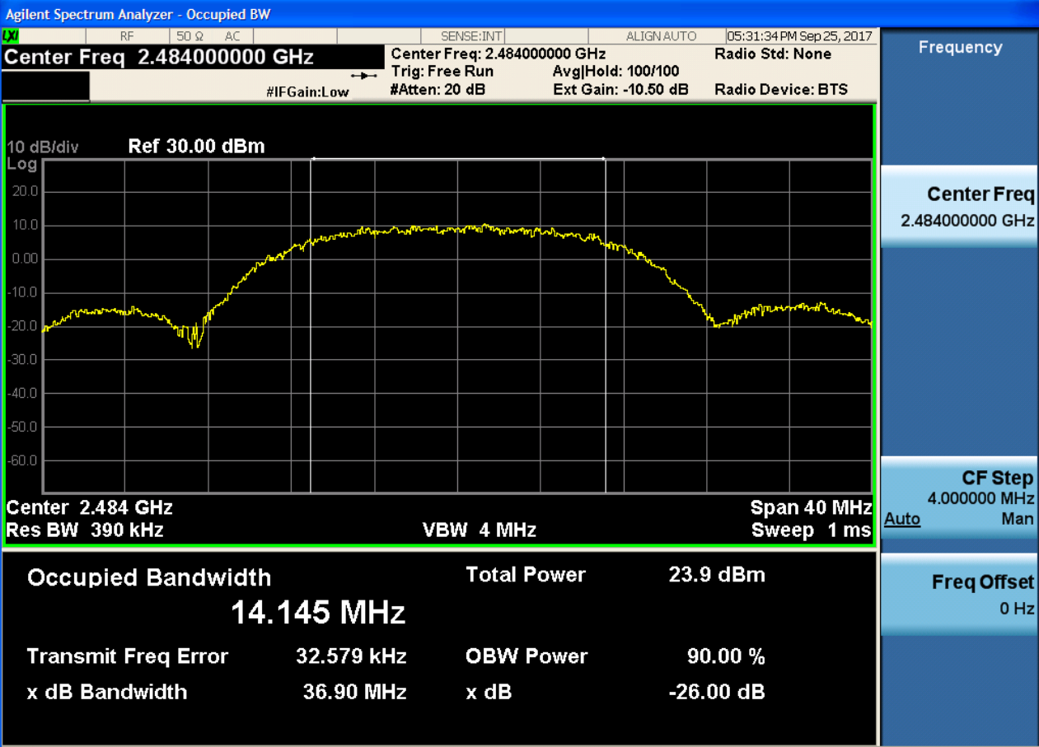
TELEC : Occupied Bandwidth and Spread-spectrum Bandwidth / Factor(14Channel)
Condition
  Using ESP8266_TELEC_20171018.bin
  14 Channel, Spread Factor >10
    1Mbps , 2Mbps > 10Mhz
    5.5Mbps, 11Mbps > 13.75Mhz
1Mbps : 14.465Mhz
Test Command
- certifc_mode_sel 2 (SRRC mode)
- wifitxout 14 0x0 8 (8 : Tx Power = 16dBm)
2Mbps :
14.226Mhz
Attenuation | 8
1M | 14.465
2M | 14.226
5.5M | 14.099
11M | 14.145
5.5Mbps
14.099Mhz
11Mbps :
14.145Mhz

Slide 5
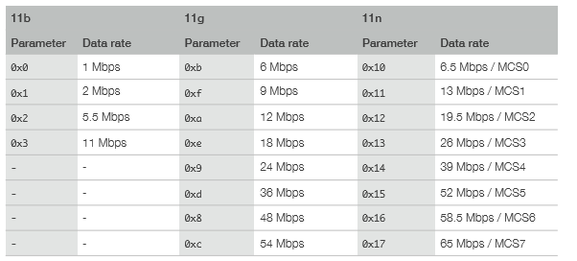
Test Command : Tx
Using ESP8285_RF_TEST_20171018.bin
Baudrate : 115200(with Both NL & CR)
Certification Command
  certific_mode_sel 1
    Ex) certifc_mode_sel=1
    Print) EMC Certification start!!!
Tx Start Command
  wifitxout <Parameter1> <Parameter2> <Parameter3>
    <Parameter1>: Select the Tx channel from 1 ~ 14
    <Parameter2>: Select the Tx data rate according to Table 1
    <Parameter3>: It is an 8-bit signed operand that indicates Tx power attenuation. The unit is 0.25 dB. Value 4 means an attenuation of 1 dB, and 252 means a gain of 1 dB
      Ex) Wifitxout 1 0x0 0
      Print) wifi tx out: channel is 1, data_rate is 11b 1.0Mb/s, bk=0,dl=0,len=4095
        Send the packets via channel 1 (2412 MHz) with the data rate of 1 Mbps
Tx Stop Command
  cmdstop
    Ex) cmdstop
    Print) Tx Over
Table 1

Slide 6
Test Command : Rx
Rx Start Command
  esp_rx <Parameter1> <Parameter2>
    <Parameter1>: Select the Rx channel from 1 ~ 14
    <Parameter2>: Select the Rx data rate according to Table 1
      Ex) esp_rx 1 0x0
      Print) wifi rx start: channel is 1, rate is 0x0
        Receive the packets via channel 1 (2412 MHz) with a data rate of 1 Mbps
Rx Stop Command
  cmdstop
    Ex) cmdstop
    Print) Correct: 0 Desired: 0 RSSI: 0

Slide 7
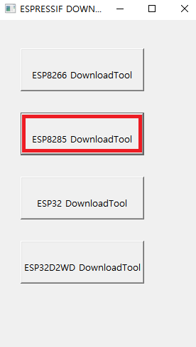
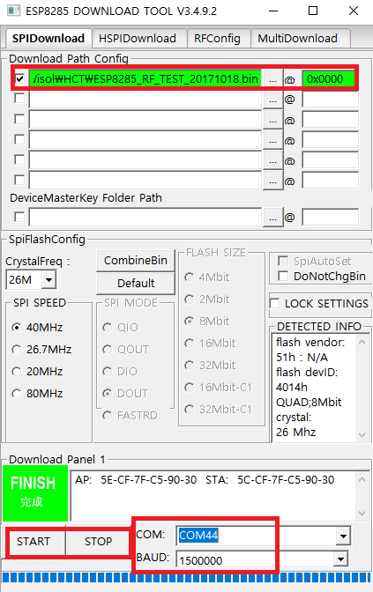
Download Tool
Double-click ESPFlashDownloadTool_v3.4.9.2.exe to run the ESP Tool
  Make sure ESP8285 works in the Download mode and the port number of the serial port is not used by other applications
Click ESP8285 DownloadTool
Select the BIN file to be downloaded in the SPIDownload menu box
  If the path is valid, it appears against a green backgound
  If the path is invalid, then it appears a red backgound
Enter a starting address in the OFFSET text box, such as “0x0000”
  The download addresses of the binary files start from “0x0000”
Set the configuration options
  Configure COM and Baud properly in your environment
Click START to download files
After the download is complete, the status bar displays Finish

